Slide 1
Introduction to Signals and Systems
M. J. Roberts - All Rights Reserved. Edited by Dr. Robert Akl

Slide 2
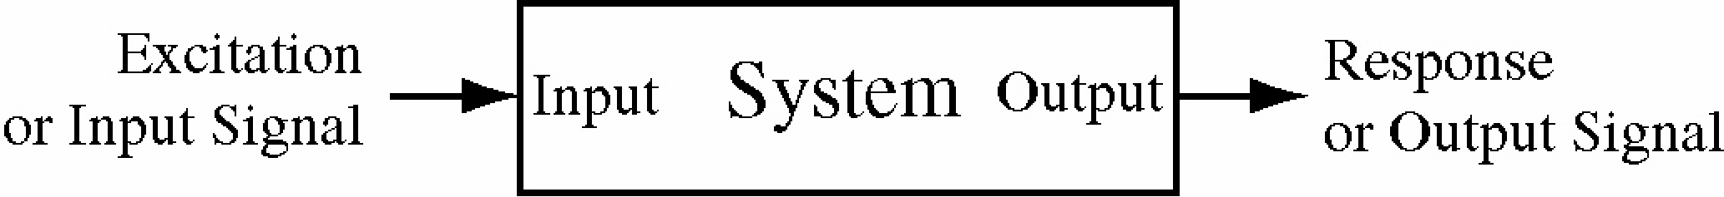
Signals and Systems Defined
A signal is any physical phenomenon which conveys information
Systems respond to signals and produce new signals
Excitation signals are applied at system inputs and response signals are produced at system outputs
M. J. Roberts - All Rights Reserved. Edited by Dr. Robert Akl

Slide 3
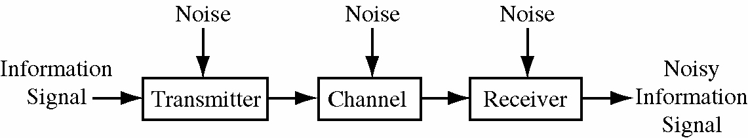
A Communication System as a System Example
A communication system has an information signal plus noise signals
This is an example of a system that consists of an interconnection of smaller systems
M. J. Roberts - All Rights Reserved. Edited by Dr. Robert Akl

Slide 4
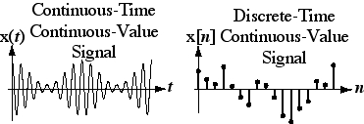
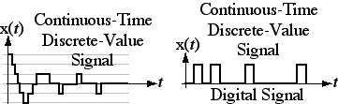
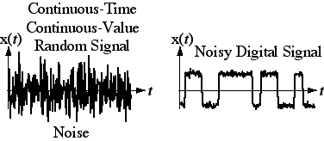
Signal Types
M. J. Roberts - All Rights Reserved. Edited by Dr. Robert Akl

Slide 5
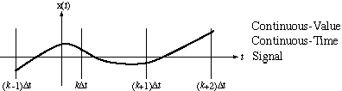
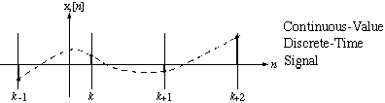
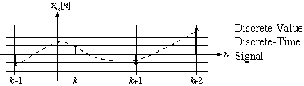
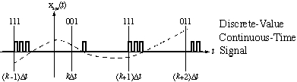
Conversions Between Signal Types
Sampling
Quantizing
Encoding
M. J. Roberts - All Rights Reserved. Edited by Dr. Robert Akl

Slide 6
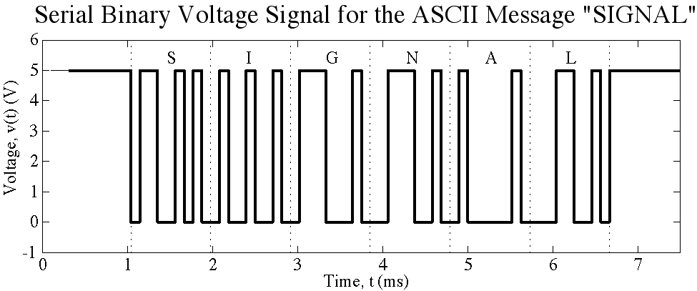
Message Encoded in ASCII
M. J. Roberts - All Rights Reserved. Edited by Dr. Robert Akl

Slide 7
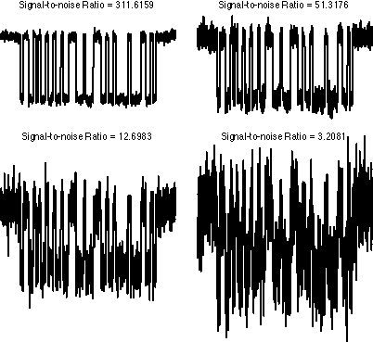
Noisy Message Encoded in ASCII
Progressively
noisier
signals
M. J. Roberts - All Rights Reserved. Edited by Dr. Robert Akl

Slide 8
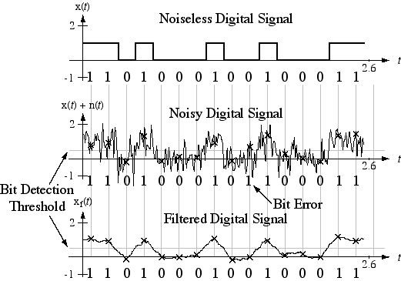
Bit Recovery in a Digital Signal Using Filtering
M. J. Roberts - All Rights Reserved. Edited by Dr. Robert Akl

Slide 9
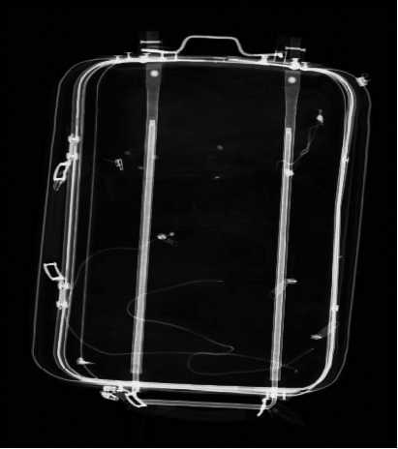
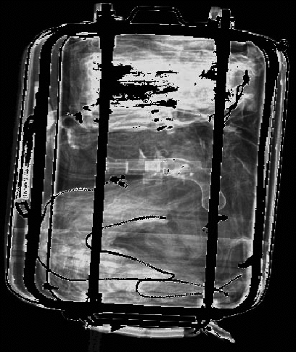
Image Filtering to Aid Perception
Original X-Ray Image
Filtered X-Ray Image
M. J. Roberts - All Rights Reserved. Edited by Dr. Robert Akl

Slide 10

Discrete-Time Systems
In a discrete-time system events occur at points in time but not
between those points. The most important example is a digital
computer. Significant events occur at the end of each clock
cycle and nothing of significance (to the computer user) happens
between those points in time.
Discrete-time systems can be described by difference (not
differential) equations. Let a discrete-time system generate an
excitation signal y[n] where n is the number of discrete-time
intervals that have elapsed since some beginning time n = 0.
Then, for example a simple discrete-time system might be
described by
M. J. Roberts - All Rights Reserved. Edited by Dr. Robert Akl

Slide 11
Discrete-Time Systems
The equation
says in words
“The signal value at any time n is 1.97 times the signal value at the
previous time [n -1] minus the signal value at the time before that
[n - 2].”
If we know the signal value at any two times, we can compute its
value at all other (discrete) times. This is quite similar to a
second-order differential equation for which knowledge of two
independent initial conditions allows us to find the solution for all
time and the solution methods are very similar.
M. J. Roberts - All Rights Reserved. Edited by Dr. Robert Akl

Slide 12
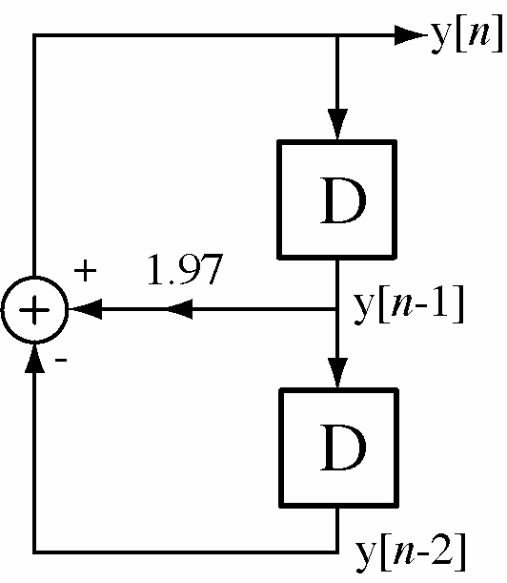
Discrete-Time Systems
We could solve this equation by iteration using a computer.
Initial Conditions
yn = 1 ; yn1 = 0 ;
while 1,
yn2 = yn1 ; yn1 = yn ; yn = 1.97*yn1 - yn2 ;
end
We could also describe the system
with a block diagram.
(“D” means delay one unit in discrete
time.)
M. J. Roberts - All Rights Reserved. Edited by Dr. Robert Akl

Slide 13
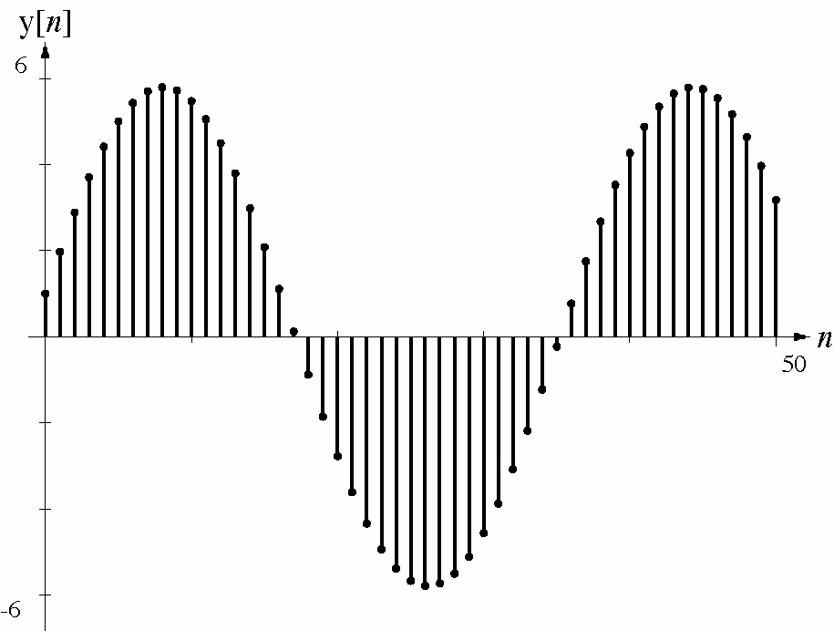
Discrete-Time Systems
With the initial conditions y[1] = 1 and y[0] = 0 the response
is
M. J. Roberts - All Rights Reserved. Edited by Dr. Robert Akl

Slide 14
Feedback Systems
In a feedback system the response of the system is “fed back”
and combined with the excitation is such a way as to optimize
the response in some desired sense. Examples of feedback
systems are
Temperature control in a house using a thermostat
Water level control in the tank of a flush toilet.
Pouring a glass of lemonade to the top of the glass without
overflowing.
A refrigerator ice maker that keeps the bin full of ice
but does not make extra ice.
Driving a car.
Feedback systems can be continuous-time or discrete-time
or a mixture of the two.
M. J. Roberts - All Rights Reserved. Edited by Dr. Robert Akl

Slide 15
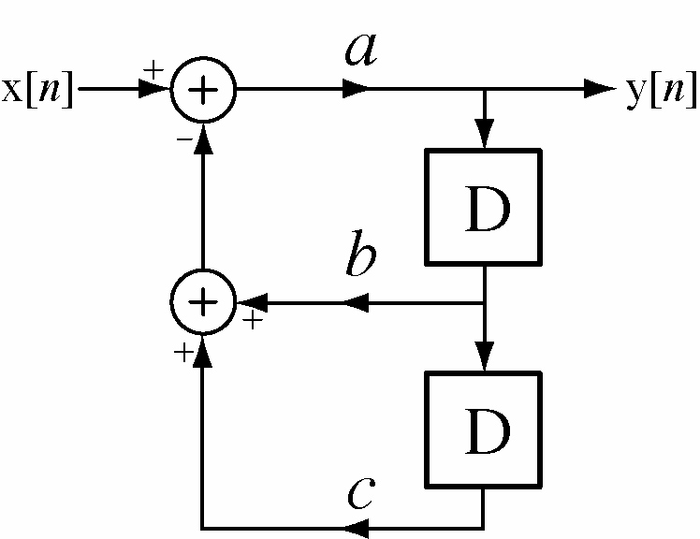
Feedback Systems
Below is an example of a discrete-time feedback system. The
response y[n] is fed back through two delays and gains b and c
and combined with the excitation x[n]. Different values of a,
b and c can create dramatically different responses to the same
excitation.
M. J. Roberts - All Rights Reserved. Edited by Dr. Robert Akl

Slide 16
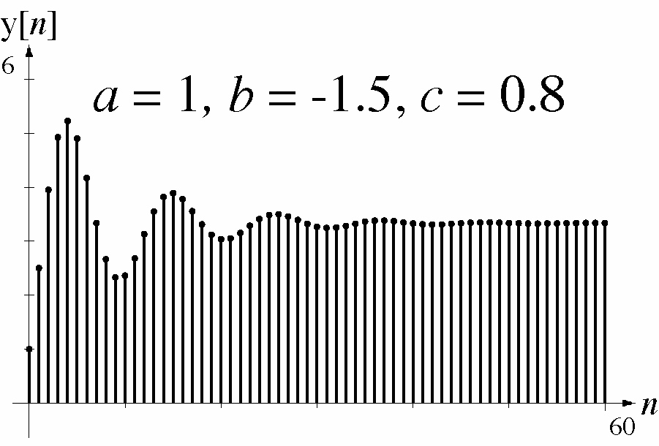
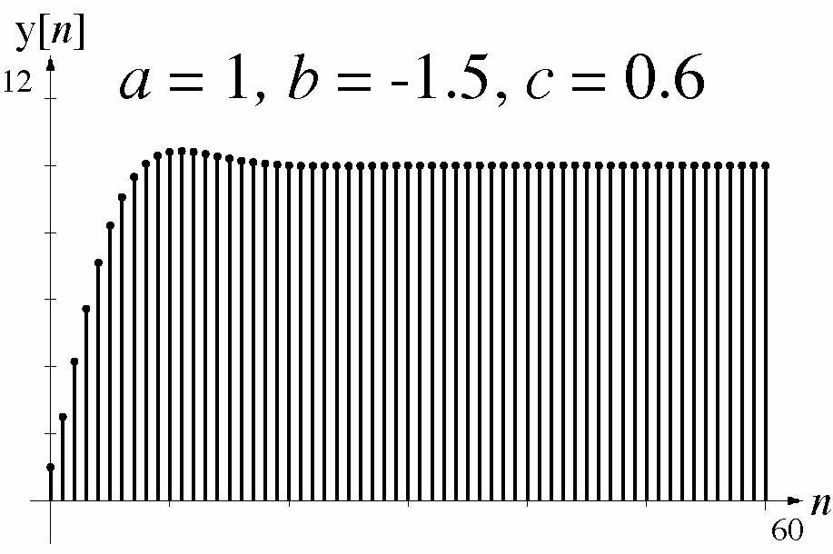
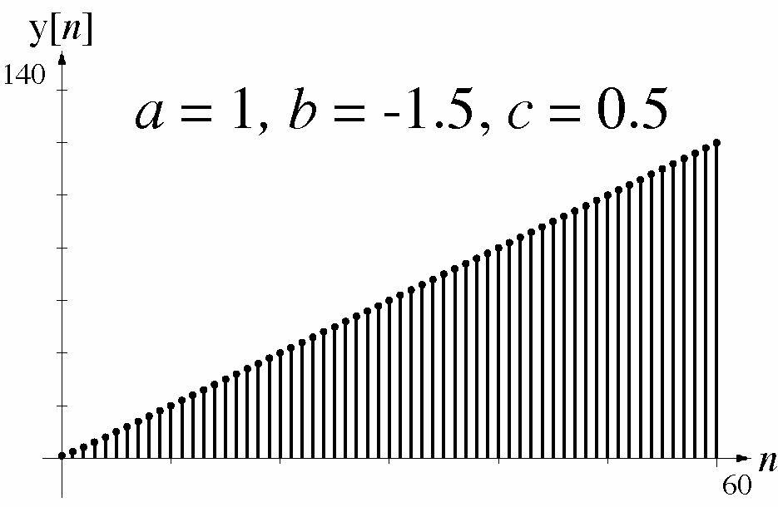
Feedback Systems
Responses to an excitation that changes from 0 to 1 at n = 0.
M. J. Roberts - All Rights Reserved. Edited by Dr. Robert Akl

Slide 17
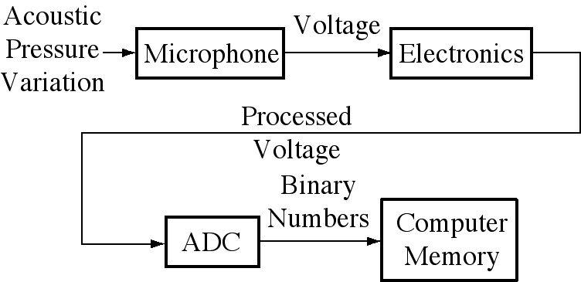
Sound Recording System
M. J. Roberts - All Rights Reserved. Edited by Dr. Robert Akl

Slide 18
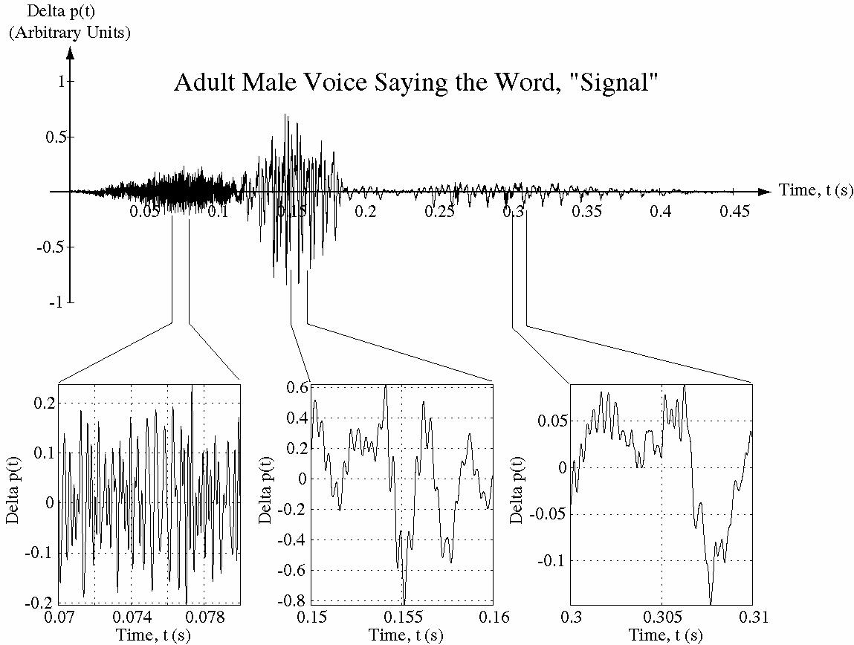
Recorded Sound as a Signal Example
“s” “i” “gn” “al”
M. J. Roberts - All Rights Reserved. Edited by Dr. Robert Akl

